Slide 1
Road Safety
COURSE CODE: 18CV562 OPEN ELECTIVE

Slide 2
Course Learning Objectives (CLO’s)
1. | To acquire knowledge and understanding of the road environment.
2. | To inculcate decision making and behavioural skills necessary to survive in the road environment.
3. | To impart knowledge and understanding of the causes and consequences of accidents.
4. | To understand the roles and responsibilities in ensuring road safety.

Slide 3
Unit 1 (8 hours)
Introduction: Importance of Transportation Engineering- Jayakar Committee Recommendations & Implementations- Road Alignment & factors Affecting the Road Alignment- Road classification. Importance and Factors Controlling The Design of Geometric Elements- Highway Cross Sectional Elements-Camber, Width of Carriage Way, Shoulder Width, Formation Width, Right of Way, Typical Cross Sections of the Roads -Pavement Surface Characteristics- Types of Pavements.
Introduction to Road Safety: Road traffic accidents scenario in India and in the world. Road Safety and its importance. Traffic Rules and Driving Behaviour.
Characteristics of accidents, accidents vs. crashes.
Specifications for Road Humps.

Slide 4
Unit 2 (8 hours)
Management of Traffic and Traffic Rules: Vehicle And Human Characteristics, PIEV Theory, Traffic characteristics, vehicular characteristics, Traffic regulation and control ( Traffic signals, Traffic signs and Road Markings), Pedestrian Facilities (zebra crossings, bus stops, use of road by physically disadvantaged persons, elderly persons, women and children)
Salient features of Motor Vehicles Act, 1988 and 2019 amendment. (Registration and Licensing Authorities in India: Their powers and duties, Legal requirements to be met for driving various classes of vehicles. classification of traffic offences. Penalties and appeals)

Slide 5
Unit 3 (8 hours)
Accidents studies and Analysis
Importance of accident studies, causes, accident studies and records, Accident
investigation, Road and its effect on accidents, parking and its influence on accidents.
Collection of Accident Data, requirement of accident records, Traffic management measures and their influence on accident prevention, cost of road accidents.
Management of Road Mishaps and Accidents: First aid to accident victims- First aid techniques, coordination with hospitals and other health centres for emergency treatment of accident victims, role of Insurance companies in providing relief to accident victims, Management of Ambulance Services, Importance of voluntary blood donation in saving accident victims, Rehabilitation of persons affected by accidents.

Slide 6
Unit 4 (8 hours)
Traffic regulations and Management of road Safety
Regulation of Speed, vehicles, regulation concerning driver and traffic
Promotion of Road Safety in India: Coordination between various local and Government Authorities for better management of road safety, compulsory safety training for drivers of all classes of vehicles. widening and improvement of quality of roads in India, role of NGOs, media and voluntary organizations in promoting road safety.
Management of Road Safety: Meaning and interpretation of various road signs, management of speed limits and enforcement of safety rules, fundamentals of vehicle maintenance for better safety on the road. Vehicle parking rules, overtaking rules, stringent penalties for repeated violations, participation of the public in ensuring safe driving conditions on the road, prevention of driving under the influence of alcohol, drugs and intoxicants. counseling and its role in accident prevention.

Slide 7
Unit 5 (8 hours)
People responsible for accident prevention, 4 E’s of Accidents Prevention, Celebration of Road Safety week or Workshop
Road safety audit
Road Safety Audits and Tools for Safety Management Systems, Road Safety Audit Process, Approach to Safety, Road Safety Improvement Strategies, ITS and Safety

Slide 8
Reference Books:
1 | Dr. S. K. Khanna, Dr. C. E. G. Justo and Dr. Veeraragavan, “Highway Engineering”, Nem Chand and Bros., Revised tenth edition,2015, Roorkee, India.
2 | Dr. L. R. Kadiyali, “Traffic Engineering & Transport Planning”, Khanna Publishers, Seventh edition, 2007, New Delhi, India.
3 | Indian Roads Congress, Highway Safety Code, IRC: SP-44:1996
4 | Indian Roads Congress, Road Safety Audit Manual, IRC: SP-88-2010
5 | Highway Safety Manual, 1st Edition, AASHTO
6 | IRC 103-1988 Guidelines for Pedestrian facilities

Slide 9
Course Outcomes (COs)
 | At the end of the course, students will be able to: | Bloom’s Level
1. | Describe the importance of transportation and road safety. | L2
2. | Explain the vehicle and human characteristics affecting road accidents. | L2
3. | Outline the salient features of motor vehicle acts and Summarize accident studies and investigations. | L2
4. | Make use of traffic regulations to manage road safety. | L3
5. | Demonstrate the importance of a multidisciplinary approach to planning for traffic safety and rehabilitation. | L2

Slide 10
Program Outcome (POs)
 | Program Outcome (POs) | PO No.
1. | Engineering Knowledge: Apply the knowledge of mathematics, science, engineering fundamentals and an engineering specialization to the solution of complex engineering problems. | 1
2. | The engineer and society: Apply reasoning informed by the contextual knowledge to assess societal, health, safety, legal and cultural issues and the consequent responsibilities relevant to the professional engineering practice. | 6
3. | Individual and team work: Function effectively as an individual and as a member or leader in diverse teams, and in multidisciplinary settings. | 9

Slide 11
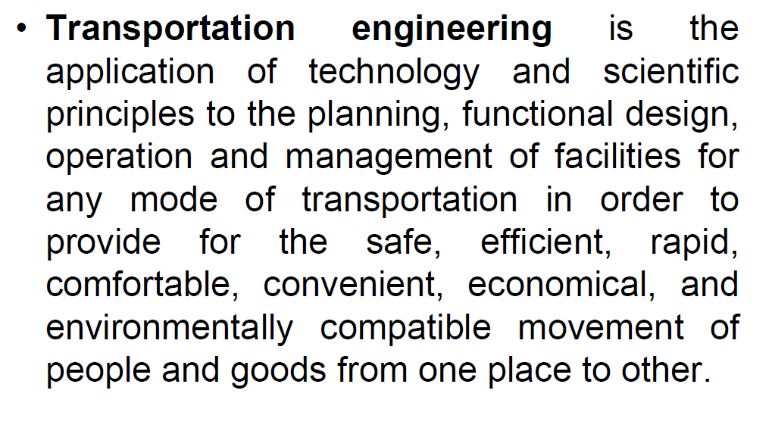
Unit 1

Slide 12
Characteristics of road transport
1. Roads are used by various types of road vehicles, like passenger cars, buses, trucks, pedal cycle and animal drawn vehicle.
2. It requires a relatively small investment for the government.
3. It offers a complete freedom to road users to transfer the vehicle from one lane to another and from one road to another according to need and convenience.
4. Speed and movement is directly related with the severity of accident.
5. Road transport is the only means of transport that offers itself to the whole community alike.

Slide 13
Highway Development in India
Jayakar Committee (1927)
Central Road Fund (1929)
Indian Roads Congress (IRC), (1934)
Central Road Research Institute (CRRI), 1950
Motor vehicle act (1936)
National Highway Authority of India (NHAI),1995
Highway Research board ( 1973 )
National Transport Policy committee ( 1978 )
First twenty year road plan ( 1943-61 )
Second twenty year road plan ( 1961-81 )
Third twenty year road plan ( 1981-2001 )

Slide 14
JayakarCommittee,1927
After the first World War, motor vehicle using the roads increases, this demanded a better road network.
In 1927,Indian road development committee was appointed by the government with M.R. Jaykar as chairman.
Road development in the country should be made as a national interest since local govt. do not have financial and technical capacity for road development.
An extra tax should be levied on petrol from road users to create the road
development fund.
To establish a semi-official ,technical institution to pool technical knowledge, sharing of ideas and to act as an advisory body.
To create a national level institution to carry research , development works
and consultation.

Slide 15
Central Road Fund
It was formed on 1st March 1929
The consumers of petrol were charged an extra leavy of 2.64 paisa per litre of
petrol to built up this road development fund.
From this 20% of annual revenue is to be retain as a central revenue for research and experimental work expenses..etc
Balance 80% is allowed by central govt. to various states based on actual
petrol consumption or revenue collected.

Slide 16
Central Road Fund , 1929 CRF Act , 2000
Distribution of 100% cess on petrol as follows:
57.5% for NH
30% for SH
12.5% for safety works on rail-Road crossing.
50% cess on diesel for Rural Road development
http://transport.bih.nic.in/Acts/The-Central-Road-Fund-Act- 2000.pdf
https://www.prsindia.org/billtrack/central-road-fund-amendment- bill-2017
http://164.100.47.193/Refinput/New_Reference_Notes/English/The
%20Central%20Road%20Fund%20amd%20bill%20-%20Main.pdf

Slide 17
IRC
The Indian Roads Congress (IRC) is the Apex Body of Highway Engineers in the country.
The IRC was set up in December, 1934 on the recommendations of the Indian Road Development Committee best known as Jayakar Committee set up by the Govt. of India with the objective of Road Development
http://www.irc.nic.in/index1.aspx?lsid=28&lev=1&lid=31&langid=1n t in India.

Slide 18
Indian Roads Congress, 1934
Central semi official technical body known as IRC was formed in 1934.
To provide national forum for regular pooling of experience and ideas on
matters related to construction and maintenance of highways.
It is a active body controlling the specification, standardization and recommendations on materials, design of roads and bridges.
It publishes journals, research publications and standard specifications guide
lines.
To provide a platform for expression of professional opinion on matters relating to roads and road transport.

Slide 19
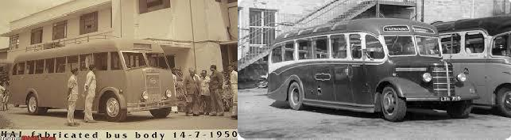
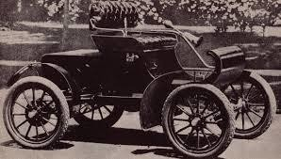
Motor vehicle act
It was formed in 1939
To regulate the road traffic in the form of traffic laws, ordinances and regulations.
Three phases primarily covered are control of driver, vehicle ownership and vehicle operation
It was revised on 1988

Slide 20
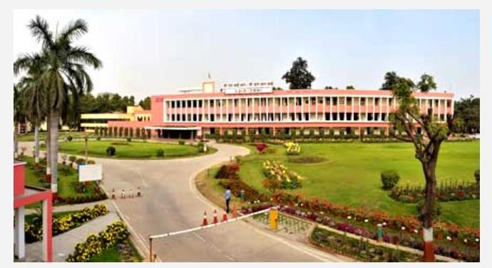
CRRI in New Delhi

Slide 21
Central Road Research Institute (1950)
Engaged in carrying out research and development projects.
Design, construction and maintenance of roads and runways, traffic and transportation planning of mega and medium cities, management of roads in different terrains
Improvement of marginal materials.
Utilization of industrial waste in road construction. Land slide control. Ground
improvements, environmental pollution.
Road traffic safety.

Slide 22
CSIR-Central Road Research Institute (CRRI), a premier national laboratory established in 1952, a constituent of Council of Scientific and Industrial Research (CSIR) is engaged in carrying out research and development projects on design, construction and maintenance of roads and runways, traffic and transportation planning of mega and medium cities, management of roads in different terrains, improvement of marginal materials, utilization of industrial waste in road construction, landslide control, ground improvements environmental pollution, road traffic safety and analysis & design, wind, fatigue, corrosion studies, performance monitoring/evaluation, service life assessment and rehabilitation of highway & railway bridges.
The institute provides technical and consultancy services to various user organizations in India and abroad. For capacity building of human resources in the area of highway Engineering to undertake and execute roads and runway projects, Institute has the competence to organize National & International Training Programmes continuing education courses since 1962 to disseminate the R&D finding to the masses.

Slide 23
Ministry of Road Transport & Highways
Planning, development and maintenance of National Highways in the country.
Extends technical and financial support to State Governments for the development of state roads and the roads of inter-state connectivity and economic importance.
Evolves standard specifications for roads and bridges in the country.
It stores the data related to technical knowledge on roads and bridges.

Slide 24
Highway Research Board
To ascertain the nature and extent of research required
To correlate research information from various organization in India and abroad.
To collect and correlation services.
To collect result on research
To channelize consultative services

Slide 25
Classification of Highways
National highway act ( 1956 )Depending on weather
All weather roads
Fair weather roads
Depending the type of Carriage way
Paved roads(WBM)
Unpaved roads(earth road or gravel road)
Depending upon the pavement surface
Surfaced roads(bituminous or cement concrete road)
Un surfaced roads

Slide 26
Classification of Highways
Based on the Traffic Volume
Heavy
Medium
Light
Based on Load or Tonnage
Class 1 or Class 2 etc or Class A , B etc Tonnes per day

Slide 27
Classification of Highways
Based on location and function ( Nagpur road plan )
National highway (NH)
State highway (SH)
Major district road (MDR)
Other district road (ODR)
Village road (VR)

Slide 28
Based on modified system of Highways classification
Primary
Expressways
National Highways
Secondary
SH State Highways
MDR Major District Roads
Tertiary
ODR Other District Roads
VR Village Roads

Slide 29
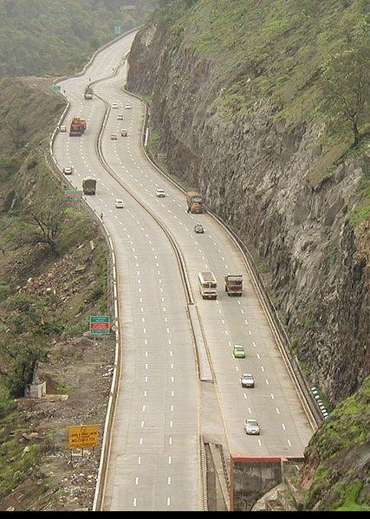
Expressways
Heavy traffic at high speed (120km/hr)
Land Width (90m)
Full access control
Connects major points of traffic generation
No slow moving traffic allowed
No loading, unloading,
parking.
Mumbai Pune Expressway seen from Kandala

Slide 30
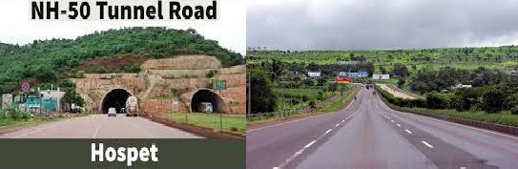
National Highway
India has a huge network of national highways.
The national highways have a total length of 70,548 kms. Indian highways cover 2% of the total road network of India and carry 40% of the total traffic.
The entire highway network of India is managed by the National Highway Authority of India
which is responsible for development and maintenance of highways.
The longest highway in India is NH7 which stretches from Varansi in Uttar Pradesh to Kanyakumari in the southern most point of Indian mainland.
The shortest highway is NH47A which stretches from Ernakulam to Kochi and covers total
length of 6 Kms.

Slide 31
State Highways
They are the arterial roads of a state, connecting up with the national highways of adjacent states, district head quarters and important cities within the state.
176,166 kilometres
State Highways are designated with SH, followed by the highway number and preceded by state code. As of 31 March 2016, the total length of state highways was 176,166 kilometres (109,464 mi).

Slide 32
Major District Roads and Other District Roads
These are major roads within a district, connecting Taluka headquarters and major rural areas to district headquarters. They also connect with the state highways and national highways. District roads are sub-classified into "Major District Roads" (MDRs) and "Other District Roads" (ODRs).
Approximately 561,940 kilometres
As on 31 March 2016, the total length of district roads in India was approximately 561,940 kilometres (349,170 mi), of which 94.93% of the total length was surfaced.

Slide 33
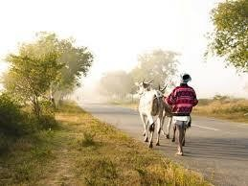
Village Roads
Regardless of their impact, rural roads form the most important component of India's
road network. Of India's 1.7 million km of roads, 73% are rural roads. A smaller but important com
https://www.worldbank.org/en/news/feature/2011/02/17/india-rural-roadsponent that the central government influences is national highways.

Slide 34
Arterial Road
No frontage access, no standing vehicle, very little cross traffic. Design Speed : 80km/hr
Land width : 50 – 60m
Spacing 1.5km in CBD & 8km or more in sparsely developed areas. Divided roads with full or partial parking
Pedestrian allowed to walk only at intersection

Slide 35
Sub Arterial Road
Bus stops but no standing vehicle. Less mobility than arterial.
Spacing for CBD : 0.5km Sub-urban fringes : 3.5km
Design speed Land width
: 60 km/hr
: 30 – 40 m

Slide 36
Collector Street
Collects and distributes traffic from local streets Provides access to arterial roads
Located in residential, business and industrial areas. Full access allowed.
Parking permitted. Design speed : 50km/hr Land Width : 20-30m

Slide 37
Local Street
Design Speed : 30km/hr. Land Width : 10 – 20m.
Primary access to residence, business or other abutting property Less volume of traffic at slow speed
Origin and termination of trips.
Unrestricted parking, pedestrian movements. (with frontage access, parked vehicle, bus stops
and no waiting restrictions)

Slide 38

CUL–DE- SAC
Dead End Street with only one entry access for entry and exit. Recommended in Residential areas

Slide 39
Factors Influencing Highway Alignment
Requirements:
Short
Easy
Safe
Economical

Slide 40
Factors controlling alignment :
Obligatory points
Obligatory points through which alignment is to pass ( bridge site, intermediate town ,
Mountain pass etc
Obligatory points through which alignment should not pass.
Traffic
Geometric design
Economics
Other considerations

Slide 41
Factors governing alignment
Obligatory points
The location should avoid obstructions such as places of cemeteries,
archeological, historical monument, public facilities like schools and hospitals, utility services.
Geometric design features
Facilitate easy grade and curvature
Enable ruling gradient in most sections
Void sudden changes in sight distance, especially near crossings
Avoid sharp horizontal curves
Avoid road intersections near bend or at the top or bottom of a hill

Slide 42
Precautions at river and railway crossings
Bridges should be preferably be located at right angles to the river flow, not located on a
horizontal curve
Crossing railway lines should avoid intersections at gradient, frequent crossing and recrossing
Topographical control points
The alignment, where possible should avoid passing through
Marshy and low lying land with poor drainage
Flood prone areas
Unstable hilly features
Avalanche prone areas
Flat terrain-below 3%
Rolling terrain -3 to 25%
Mountainous terrain – above 25%
A location on high ground should be preferred rather than valley to avoid cross drainage works

Slide 43
Factors governing alignment
Materials and constructional features
Deep cutting should be avoided
Earth work is to be balanced; quantities for filling and excavation
Alignment should preferably be through better soil area to minimize pavement thickness
Location may be near sources of embankment and pavement materials
Traffic
Trend, Direction and pattern of traffic are critical elements.
OD survey should be conducted.
Desire lines based on survey should be drawn to indicate the desired pattern of traffic flow.

Slide 44
ECONOMIC FACTORS
Capital cost Maintenance Cost Operational cost Road User Cost
Embankment and deep cuttings cost.

Slide 45
Other Considerations
Engineering feasibility
Environmental consideration
Social consideration
Political Acceptability
Monotony.

Slide 46
Highway Cross Sectional Elements

Slide 47
